Slide 1
Behavior Trees
Concordia University | COMP 476 - Lab
Lab Slides created by Daniel Rinaldi

Slide 2
Behavior Trees
Concordia University | COMP 476 - Lab
Lab Slides created by Daniel Rinaldi
Behavior Trees are a popular AI technique used in many games. Halo 2 was one of the first mainstream games to use behavior trees and they started to become more popular afterwards.
You can find a detailed description of how they were used in Halo 2 here: https://www.gamedeveloper.com/programming/gdc-2005-proceeding-handling-complexity-in-the-i-halo-2-i-ai
Behavior trees are a combination of many different techniques: hierarchical state machines, scheduling, planning, and action execution. One of their main advantages is that they are easy to understand both visually (if you draw them out) and programmatically.
Behavior Trees can be defined by the following characteristics:
Tree data structure: They start at a root node and are designed to be traversed in a specific order until a terminal state is reached (success or failure).
Leaf nodes are executable behaviors: Each leaf will do something, whether it’s a simple check or a complex action, and will output a status (success, failure, or running). In other words, leaf nodes are where you connect a BT to the lower-level code for your specific application.
Internal nodes control tree traversal: The internal (non-leaf) nodes of the tree will accept the resulting status of their children and apply their own rules to dictate which node should be traversed next.

Slide 3
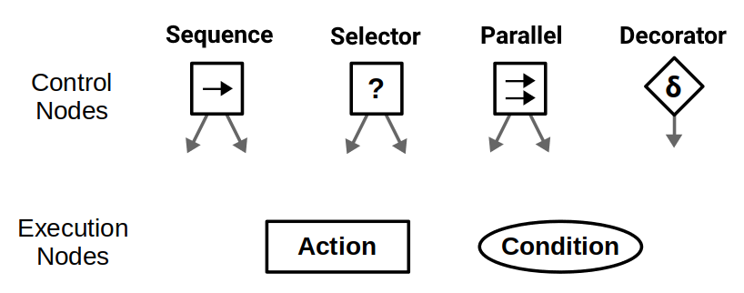
Behavior Trees
Concordia University | COMP 476 - Lab
Lab Slides created by Daniel Rinaldi
Behavior tree terminology
Behavior trees execute in discrete update steps known as ticks. When a Behavior tree is ticked, usually at some specified rate, its child nodes recursively tick based on how the tree is constructed. After a node ticks, it returns a status to its parent, which can be Success, Failure, or Running.
Execution nodes, which are leaves of the Behavior tree, can either be Action or Condition nodes. The only difference is that condition nodes can only return Success or Failure within a single tick, whereas action nodes can span multiple ticks and can return Running until they reach a terminal state. Generally, condition nodes represent simple checks (e.g., “is the path open?”) while action nodes represent complex actions (e.g., “open the door”).
Control nodes are internal nodes and define how to traverse the Behavior tree given the status of their children. Importantly, children of control nodes can be execution nodes or control nodes themselves. Sequence, Selector, and Parallel nodes can have any number of children, but differ in how they process said children. Decorator nodes only have one child, and modify its behavior with some custom defined policy.

Slide 4
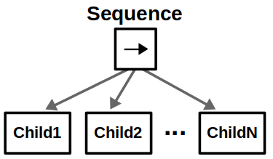
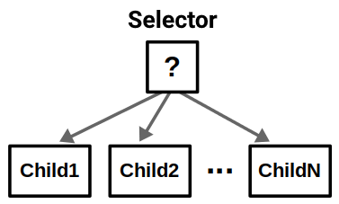
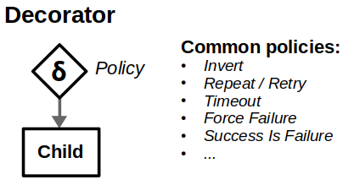
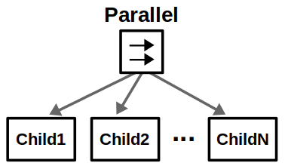
Behavior Trees
Concordia University | COMP 476 - Lab
Lab Slides created by Daniel Rinaldi
Control Nodes
Sequence nodes execute children in order until one child returns Failure or all children returns Success.
Selector nodes execute children in order until one of them returns Success or all children return Failure. These nodes are key in designing recovery behaviors for your AI agents.
Parallel nodes will execute all their children in “parallel”. This is in quotes because it’s not true parallelism; at each tick, each child node will individually tick in order. Parallel nodes return Success when at least M child nodes (between 1 and N) have succeeded, and Failure when all child nodes have failed.
Decorator nodes modify a single child node with a custom policy. A decorator has its own set of rules for changing the status of the “decorated node”. For example, an “Invert” decorator will change Success to Failure, and vice-versa. While decorators can add flexibility to your behavior tree arsenal, you should stick to standard control nodes and common decorators as much as possible so others can easily understand your design.

Slide 5
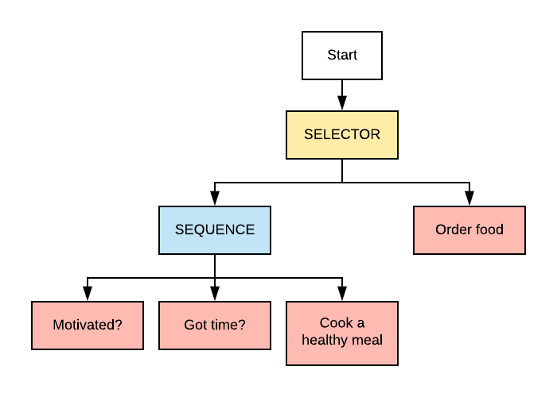
Behavior Trees
Concordia University | COMP 476 - Lab
Lab Slides created by Daniel Rinaldi
Simple Example
Imagine a very simple scenario where you’re hungry and you’re trying to decide if you’re going to cook a meal or just order food. We can represent that with a behavior tree, like the following one:

Slide 6
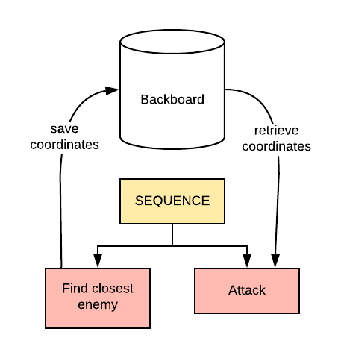
Behavior Trees
Concordia University | COMP 476 - Lab
Lab Slides created by Daniel Rinaldi
Blackboard
In almost all scenarios, some nodes will want to “talk” to other nodes. Behavior Trees can have some kind of data store called a blackboard (also known as data context) that is global and accessible from all other nodes.
For example: Imagine you have a node that finds the closest enemy and another one that attacks it. The one that finds the enemy would put its coordinates in the blackboard and the one attacking it would retrieve the information and proceed.
This data store can be as simple as a dictionary of <string, object>.

Slide 7
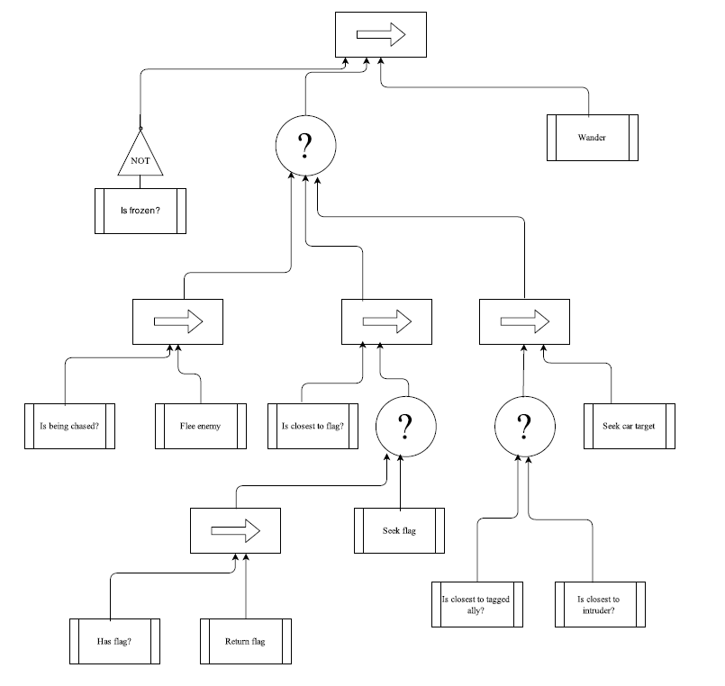
Tasks
Concordia University | COMP 476 - Lab
Lab Slides created by Daniel Rinaldi
Construct the Behavior Tree
All the code needed to load the behavior tree from an xml file is given to you. All you must do is fill in the xml file to match the behavior illustrated by the graph on the right.

Slide 8
Thank You
Concordia University | COMP 476 - Lab
Lab Slides created by Daniel Rinaldi

Slide 9
Other Links
https://docs.unity3d.com/2020.3/Documentation/Manual/index.html
https://docs.unity3d.com/2020.3/Documentation/Manual/ExecutionOrder.html
https://www.youtube.com/watch?v=nKpM98I7PeM&ab_channel=TheKiwiCoder
Concordia University | COMP 476 - Lab
Lab Slides created by Daniel Rinaldi

